Slide 1

Children’s Cabinet
March 23rd, 2026

Slide 2
Agenda
Welcome and Introductions
Vote on adoption of November meeting Minutes
Housekeeping
Strategic Plan Implementation Kick Off
Public Comment
Adjournment

Slide 3
Rhode Island Children’s Cabinet
Strategic Plan Implementation Kickoff
March 23, 2026

Slide 4
Starting Point and Where We’re Headed
Starting Point
  The Children’s Cabinet finalized its 2026-2030 Strategic Plan at the end of 2025
  An excerpt of the Strategic Plan can be found in the appendix
2026 Goals
  This year, the Cabinet will focus on planning for and implementing the key strategic initiatives outlined in the 2026-2030 Strategic Plan
Implement Strategic Plan
Create an Action Plan and Detailed Workplan
The action plan will outline the implementation approach and process for rolling out key initiatives. The action plan will define how the Cabinet will move forward on key initiatives.
Once the implementation approach has been established, we will develop a detailed workplan outlining the steps that will be taken to execute on key initiatives.
Develop a Success Measure Data Collection and Monitoring Plan
This plan will define success measures, identify sources of data, establish targets and document processes for collecting and reporting on measures on an ongoing basis.
Initiate Rollout
Begin executing on key initiatives as implementation approach is defined.

Slide 5
Meeting Goal 1: Prioritize and Sequence Key Strategic Initiatives
As we begin to develop the action plan, the Cabinet will need to prioritize initiatives and sequence its activities to acknowledge priority level and key dependencies.
Today’s Process
Step 1
  Review Key Strategic Initiatives
Step 2
  Review Straw Proposal for Phasing Key Strategic Initiatives
Step 3
  Refine and Confirm Phasing and Timeline

Slide 6



Reminder: Key Strategic Initiatives
Goals
Objectives
Key Strategic Initiatives
Goal 1:
Provide interagency coordination and leadership that drives improvement in the well-being of Rhode Island’s children and youth
Implement a new meeting structure and process
[O1] Maximize collective impact
[O2] Improve outcomes for RI’s children and youth
Establish a framework and select high-impact focus areas
Goal 2:
Strengthen the Children’s Cabinet’s capacity to execute on its Mission
[O1] Build a staffing structure that drives effective execution
Establish an interagency staff team and project management structure
[O2] Strengthen data-driven decision making
Select outcome measures aligned with focus areas and establish a plan for ongoing reporting and monitoring
[O3] Enhance community engagement
Develop enhanced community engagement processes
Goal 3:
Align and maximize available funding to advance interagency priorities
[O1] Maximize efficient deployment of resources
Establish a process to inventory programs and investments associated with selected focus areas
[O2] Align on budgetary risks and state budget strategy
Establish an annual process aligned with the state budget calendar to coordinate on budget and authority related requests

Slide 7
Straw Proposal for Phasing Key Strategic Initiatives
March Meeting
May Meeting
July Meeting
Sept Meeting
Project Initiation
Determine approach to enhancing community engagement and establish a framework for selecting high-impact focus areas
Implement a new meeting structure and process
Phase 1
Select focus areas and associated outcome measures and discuss how to organize the staff team and project management structure to begin implementation work
Develop enhanced community engagement processes
With focus areas and measures selected, discuss longer-term processes for reviewing investments and aligning with the state budget calendar
Establish a framework and select high-impact focus areas
Phase 2
Select outcome measures aligned with focus areas and establish a plan for ongoing reporting and monitoring
Establish an interagency staff team and project management structure
For Discussion
Is this the right prioritization of key initiatives?
Are there any initiatives that should be re-prioritized for discussion sooner?
Are there any dependencies that haven’t been contemplated that would lead us to sequence initiatives differently?
Phase 3
Establish a process to inventory programs and investments associated with selected focus areas
Establish an annual process aligned with the state budget calendar to coordinate on budget and authority related requests that advance interagency priorities

Slide 8

Meeting Goal 2: Confirm Meeting Structure and Process
  Strategic Initiative: Implement a new meeting structure and process
Straw Proposal Implementation Approach
Restructure 2026 meeting calendar to an every other month cadence and elongate meetings to 1.5 hours to allow deeper engagement during meetings
For Discussion
Note that we will discuss community engagement at our next meeting
Any amendments to this approach?
Is there anything else we should incorporate to enable deeper engagement?
2026
Utilize 2026 meetings to engage the cabinet and the public in key decisions to inform execution of strategic initiatives
Leverage pre-reads and pre/post meeting feedback collection tools to prepare the cabinet and the public for decision-oriented meetings
Nov
2026
Evaluate meeting structure and process and confirm any refinements for 2027
Jan
2027
Implement updates to meeting structure and process as needed in 2027
Milestone
Activity

Slide 9
Meeting Goal 3: Preview Implementation Tools
Through this process, we’ll be developing three key tools to support implementation:
Action Plan: Milestone Tracker
Action Plan: Detailed Workplan
Data Collection and Monitoring Plan
1
2
3
For Discussion
Are there any other tools you anticipate the Cabinet will need to effectively rollout strategic plan initiatives?
Are there any modifications we should make to these tools to make them more effective?

Slide 10
Action Plan: Milestone Tracker
Outlines key milestones, target timing for completion and status
1

Slide 11
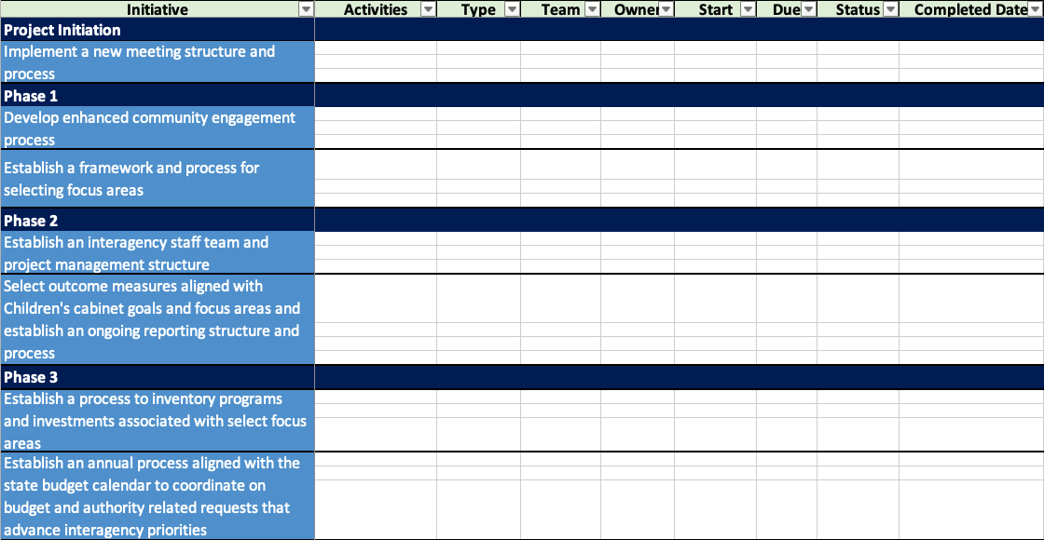
Action Plan: Detailed Workplan
2
Defines detailed activities, owners, timelines and status

Slide 12
Data Collection and Monitoring Plan
Identifies data sources and definitions for success and outcome measures
3

Slide 13

Discussion and Next Steps
For Discussion
Any questions, comments or feedback on where we’re headed this year?
Any priorities for this year that are not yet reflected here?
At our next meeting, we plan to discuss the Cabinet’s approach to:
Enhancing community engagement
Establishing a framework for selecting high-impact focus areas
In follow-up to this meeting, we will be distributing an initial list of the focus area selection criteria and potential focus areas that we discussed last year.
Before the May meeting, we ask that you review the initial list of selection criteria and focus areas and fill out a feedback form to propose any additional selection criteria and focus areas that you would like the Children’s Cabinet to consider.

Slide 14
Appendix
Children’s Cabinet Strategic Plan 2026-2030
Excerpt: Goals, Objectives, Initiatives, and Measures

Slide 15

Children’s Cabinet: Mission, Vision, and Goals
Mission
We, the leaders and agencies serving children and families in Rhode Island, come together to ensure that our children and youth have opportunities for safe, healthy and bright futures. By providing the overarching leadership and holistic approach necessary to improve the well-being of our children and youth, we set our State on a path toward a more stable and successful future.
Vision
All Rhode Island children have an opportunity for safe, healthy and bright futures.
Goals
External Stakeholders
(Rhode Island Children and Youth)
Organizational Capacity & Effectiveness
(People, Culture, Infrastructure, Systems, Processes)
Financial
(Sustainability and Efficiency)
Goal 1:
Provide interagency coordination and leadership that drives improvement in the well-being of Rhode Island’s children and youth.
Goal 2:
Strengthen the Children’s Cabinet’s capacity to execute on its Mission.
Goal 3:
Align and maximize available funding to advance interagency priorities.

Slide 16
Goal 1: Objectives, Strategic Initiatives, and Success Measures
Objectives
Strategic Initiatives
Success Measures
[S1] Ensure priorities are selected with consideration for serving all RI children and youth (ages 0-24), advancing the goals of RI 2030, and incorporating priorities across health, education, and workforce
[S2] Clearly define scope within the context of other interagency forums and coordinate as needed
[S3] Restructure meeting purpose, structure, and process around selected focus areas and work issues across multiple meetings
[S4] Strengthen interagency data-sharing, coordination, and collaboration
[S5] Work across agencies to understand, address, and communicate federal policy changes
[SM1] Establishment of focus area selection criteria that ensure the Children’s Cabinet considers its objectives and the work of other interagency forums as it selects priority focus areas
[SM2] Implementation of new meeting structure and process
[SM3] Member agency satisfaction with meetings, data sharing, and overall coordination and collaboration
[O1] Maximize collective impact
Goal 1:
Provide interagency coordination and leadership that drives improvement in the well-being of Rhode Island’s children and youth
[S1] Establish a data-driven framework and process for selecting focus areas
[S2] Select a limited number of high-impact priority and/or population focus areas
[S3] Develop a process for executing selected initiatives within focus areas
[SM1] Completion and documentation of framework and process for selecting focus areas
[SM2] Selection of high-impact focus areas and targeted outcomes measures
[SM3] Meet or exceed targeted outcomes for each focus area [measures TBD]
[O2] Improve outcomes for RI’s children and youth

Slide 17
Goal 2: Objectives, Strategic Initiatives, and Success Measures
Objectives
Strategic Initiatives
Success Measures
[S1] Establish an interagency staff team with appointees from member agencies who are responsible for coordinating within their agency to advance work on selected focus areas
[S2] Establish a structure to manage workstreams with clear roles, accountability, and project tracking
[S3] Leverage ad hoc committees with the appropriate subject matter experts as needed to advance progress on key initiatives
[SM1] All member agencies have appointed a staff person to the interagency staff team, as applicable
[SM2] Establishment of interagency staff team project management structure and processes
[SM3] Member agency satisfaction with structure, role clarity, and accountability
[O1] Build a staffing structure that drives effective execution
Goal 2:
Strengthen the Children’s Cabinet’s capacity to execute on its Mission
[S1] Select outcome measures aligned with Children’s Cabinet goals and focus areas that leverage existing measure sets and are evidence-based
[S2] Establish a reporting structure and process – report on Cabinet progress at least annually
[S3] Use shared data to execute on initiatives and improve outcomes
[SM1] Establishment of annual report on selected outcome measures
[SM2] Member agency satisfaction with data reporting, data quality and use of shared data in decision making
[O2] Strengthen data-driven decision making
[S1] Enhance the Children’s Cabinet’s ability to gather and utilize community input
[S2] Improve the community’s ability to access and contribute to hybrid meetings
[S3] Update the website regularly to ensure access to timely and useful information
[SM1] Average # of non-Cabinet member participants in Cabinet meetings
[SM2] Member agency and external stakeholder satisfaction with enhancements [i.e., meeting structure, input gathering, website]
[O3] Enhance community engagement

Slide 18
Goal 3: Objectives, Strategic Initiatives, and Success Measures
Objectives
Strategic Initiatives
Success Measures
[S1] Inventory programs and investments associated with selected focus areas
[S2] Analyze service gaps and overlaps and use evidence-based approach to deploy resources effectively
[S3] Prioritize evidence-based investments that maximize impact/ROI
[SM1] Complete inventory of programs and investments associated with selected focus area
[SM2] Member agency satisfaction with resource prioritization and utilization
Goal 3:
Align and maximize available funding to advance interagency priorities
[O1] Maximize efficient deployment of resources
[S1] Establish an annual process aligned with the state budget calendar to coordinate on budget and authority related requests that advance interagency priorities
[S2] Collaborate on key federal and state budget risks and strategies
[SM1] Implementation of annual process aligned with state budget calendar
[SM2] Member agency satisfaction with coordination, collaboration, and alignment on agency budget requests and shared risks and strategies
[O2] Align on budgetary risks and state budget strategy

Slide 19
Public Comment

